Slide 1


Slide 2
Team - 5
EMPLOYEE ATTENDANCE BASED SALARY
Supervisor
Dr. K. Ravi Chaitanya,
Assistant Professor in CSE
Team Members
G.Tharun Teja(20K45A0405)
A.Vinay Kumar(20K45A0401)

Slide 3
Abstract:
Staff Attendance System is a simple windows based attendance system that was specifically developed for small and medium scale companies. This software helps to manage the workforce and attendance and calculates the salary for attending days in an easier way. This software application can manage the recordings, control and monitor the attendance. The significance of this application is to make sure that the staff members attendance management and calculation of salary for attend days. Currently, there is no proper system to monitor the staff attendance at some companies. Some companies still use the paper based system to store the records of the employees. With the implementation of this system, paper based systems will be eliminated. This research will help the Administrator to manage recordings, monitoring and tracking the attendance of the employees. It provides an accurate attendance every day and accurate salary calculation management for the employees in order to sign in and sign out their attendance. In this paper, the Employee Attendance Based Salary System was developed using java programming language

Slide 4
IMPLEMENTATION
In implementation of our application we used.
JFrame, JLabel, JButton, JComboBox and other methods.
By integrating all these things we designed our application.

Slide 5
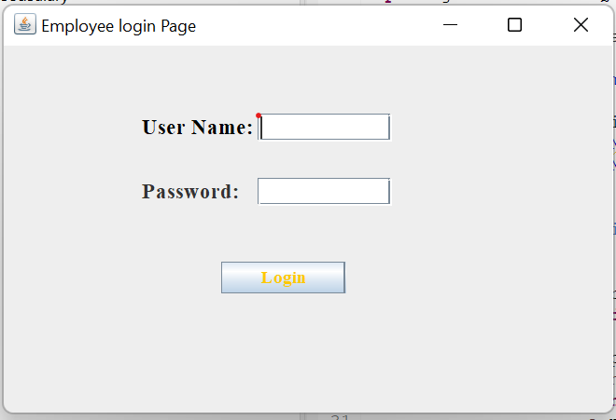
Application:
It asks username and password.
Employee1 :
Username:tharun
password:1234

Slide 6
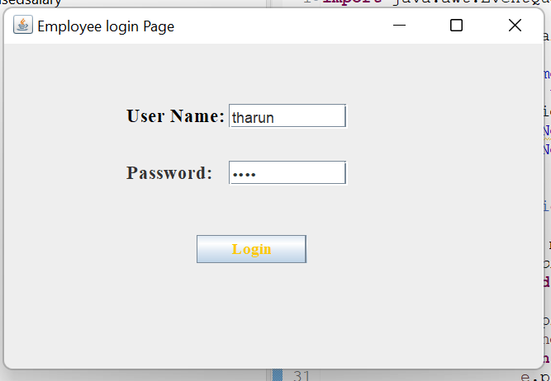

Slide 7
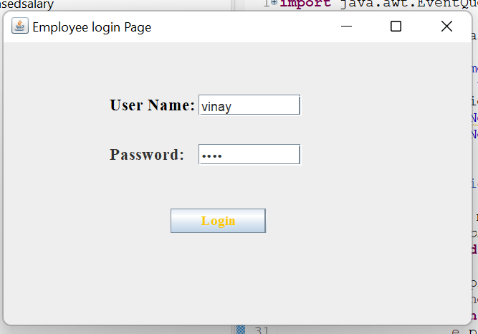
It asks username and password.
Employee2:
Username:vinay
password:5678

Slide 8
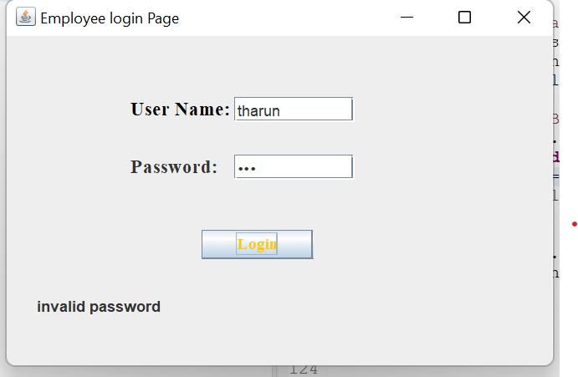
LOGIN ERROR:

Slide 9
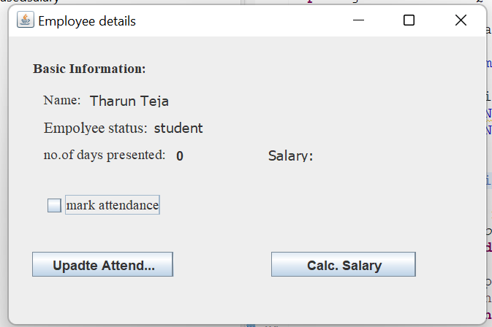
This is the employee details of employee 1 it consists of basic information.By clicking the update attendance we get marks successfully page.

Slide 10
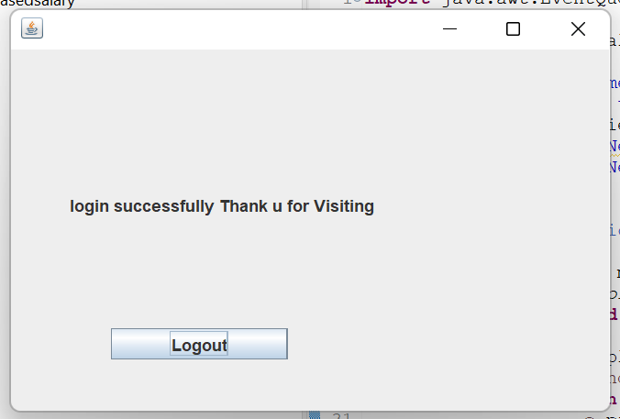
After clicking update attendance button.It shows login successfully thank u fo visiting and it update attendance as 1.

Slide 11
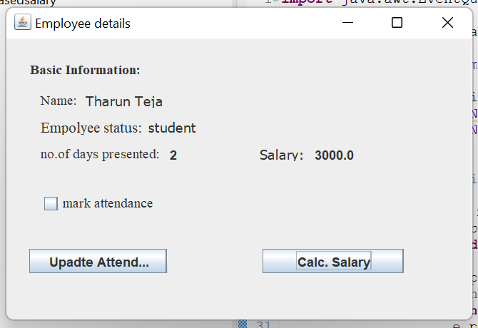
After clicking the salary button.it shows the salary for attended days.the presented days is 2 and per each day 1500(2*1500=3000).

Slide 12
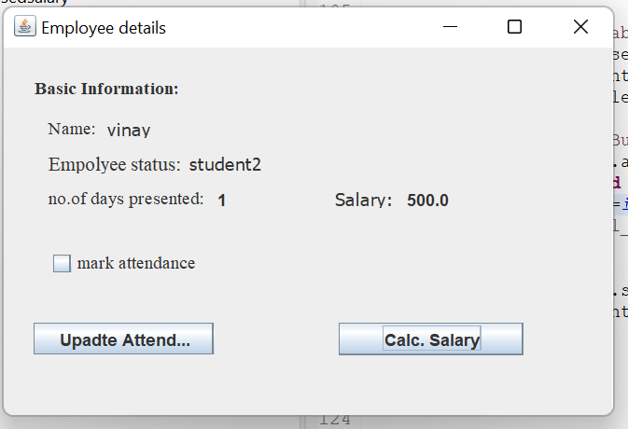
After clicking the salary button.it shows the salary for attended days.the presented days is 2 and per each day 500(1*500=500).

Slide 13
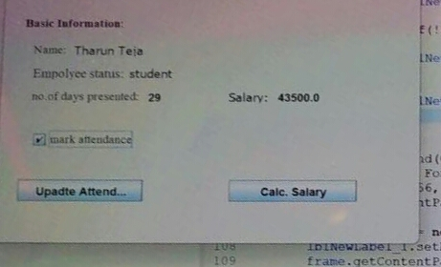
RESULT:

Slide 14


